Slide 1
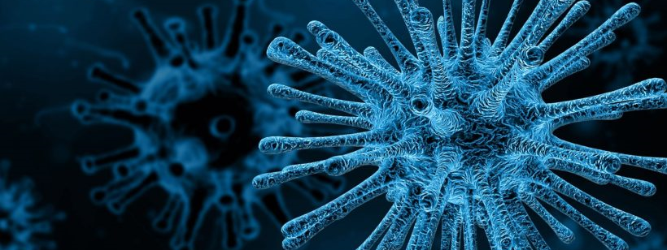
Machine Learning: Predicting COVID-19 Diagnoses
Martha Karran
Columbia University
April 2020

Slide 2
Background
COVID-19 is caused by SARS-CoV-2
2.3 million cases with >150,000 deaths globally
700,000 cases with >37,000 deaths in the US
Neurological complications:
Some Coronavirus Patients Show Signs of Brain Ailments¹
Cytokine Storm in COVID-19 and Treatment²
Rabin, R. (2020). Some Coronavirus Patients Show Signs of Brain Ailments. http://www.nytimes.com/2020/04/01/health/coronavirus-stroke-seizures-confusion.html
Ye Q. (2020). Journal of Infection. 17(20). doi: 10.1016/j.jinf.2020.03.037.

Slide 3
Dataset
Kaggle
Diagnosis of COVID-19 and its clinical spectrum³
Usability 4.7
Sparse test results
Standard lab tests
3. Source: Hospital Israelita Albert Einstein - https://www.kaggle.com/einsteindata4u/covid19

Slide 4
Primary Objective
Using laboratory tests to predict COVID diagnosis
↑ C-reactive protein (CRP) and ↓ white blood cells (WBCs)⁴
4. Singhal T. (2020). A Review of Coronavirus Disease-2019 (COVID-19). Indian journal of pediatrics. 87(4), 281–286. https://doi.org/10.1007/s12098-020-03263-6

Slide 5
Data Cleaning
Data exploration
Remove unnecessary columns & rows
Empty columns and rows
Tests for other diseases
Less common tests
Rename columns
Simple imputation (means)
Representative subset
506 of 5644 rows remain
14% COVID-19 +

Slide 6
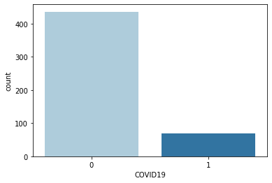
Visualizing the Data
506 patients
436 negative cases
70 positive cases

Slide 7
Imbalanced Classification
Random Under-Sampling
Improves run time and storage issues
Random Over-Sampling
No loss of datapoints
Increases the likelihood overfitting
Synthetic Minority Oversampling Technique (SMOTE)
Uses KNN
Only on training data

Slide 8

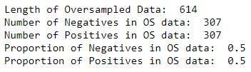
Oversampled Data
Splitting into training and testing data before oversampling
A look at the oversampled training data

Slide 9
Feature Engineering
Recursive Feature Elimination (RFE)
Recursively removes 16 features → 10 features
rfe.support_
Returns Boolean – TRUE if selected feature remains
rfe.ranking_
Returns Ranking – selected features assigned rank 1
These 10 features fed into logistic regression model
Dependent variable: COVID-19 diagnosis

Slide 10
Feature Selection
Logistic Regression Results
p < 0.005
Small dataset and overfitting concerns
Select features that contribute significantly
Repeat to remove features that do not contribute significantly
Five features selected:
CRP, Neutrophils, Platelets, WBCs, Eosinophils

Slide 11
Training & Testing the Model
Independent Variables:
CRP, Neutrophils, Platelets, WBCs, Eosinophils
Dependent Variable:
COVID-19 diagnosis
Train the model using .fit
Test the model using .predict

Slide 12
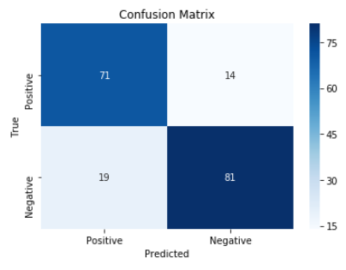
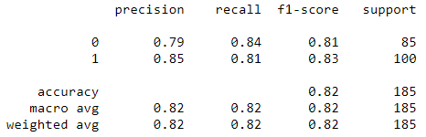
Evaluating the Model
Classification Report

Slide 13
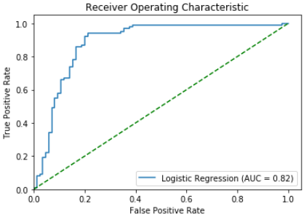
Evaluating the Model
Receiver Operating Characteristic (ROC) Curve
Area Under the Curve (AUC)

Slide 14

Limitations
Relatively small dataset
Demographics not available
Feature selection

Slide 15
Future Research
Assess severity using the type of admission
Can inform a model assessing neurological complications of COVID-19

Slide 16
Questions
Thank you!
Questions?

